Slide 1






NITYO INFOTECH
AI CAPABILITY PRESENTATION
Artificial Intelligence
at Nityo Infotech
Human talent and agentic AI, working as one governed workforce at global scale.
Data & AI Engineering
Agentic Workforce
Governance & Delivery

Slide 2













NITYO INFOTECH
GLOBAL IT SERVICES • DATA & AI SOLUTIONS
Nityo Infotech at a Glance
A global technology partner delivering IT services, data, and AI-powered solutions at enterprise scale
COMPANY SNAPSHOT
2006
50+
3,000+
41
31,000+
15+
Founded
Awards
Clients Globally
Countries
Employees
Industry Verticals
AI-POWERED CAPABILITIES
Agentic AI Workforce
Deep-Tech AI Solutions
AI & ML for Financial Services
Conversational AI
Strategic partnership with Wand AI to deploy governed, production-grade AI agents across enterprise operations.
Reconstructing legacy systems into simple, efficient platforms powered by applied AI and ML.
Purpose-built AI and machine learning solutions for banking, capital markets, and financial services.
Intuitive, personalized, real-time AI-driven customer interactions at enterprise scale.
Certifications
ISO 27001:2013
CMMIDEV / 5
bizSAFE3

Slide 3








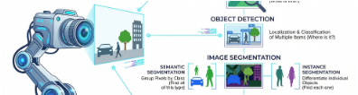








NITYO INFOTECH
Where our AI systems create the most value today
Agentic Platform
Computer Vision
Natural Language
Predictive models trained on historical data to forecast outcomes and trends dynamically.
Image and video recognition for quality control, automated detection, and visual search.
Understanding, summarizing, and generating text seamlessly across support and content workflows.
Data Analytics
Automation
Trust & Safety
Turning large, messy enterprise datasets into clear, actionable, and real-time business insights.
AI-driven workflows that remove manual, repetitive operational work to accelerate output.
Built-in guardrails, rigorous monitoring, and enterprise compliance across every deployed model.

Slide 4




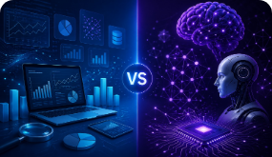







NITYO INFOTECH
AI Capability
Nityo pairs its global data & AI engineering bench with Wand AI's agentic operating system, letting enterprises run AI agents and human teams as one governed workforce across core business functions.
Data & AI Engineering
Agentic Workforce Deployment
Centralized Governance
Global Rollout & Support
Full-stack data, ML, and platform engineering teams build the pipelines and models that power enterprise AI initiatives.
An enterprise control panel manages agent autonomy, budgets, auditability, and performance benchmarking under tight compliance.
Nityo-led implementation, localization, and support across 40+ countries scale AI from pilot processes to hundreds at once.
Strategic partnership with Wand AI brings a production-grade agent workforce that executes end-to-end workflows alongside human teams.
Nityo Infotech Enterprise Solutions
Data & AI Capabilities

Slide 5










NITYO INFOTECH
Forward Deployment Capability
Nityo places domain-ready engineers, consultants, and delivery squads directly inside client environments — compressing the distance between decision and execution across global programs.
Rapid On-Site Mobilization
Global Delivery Bench
Domain-Ready Squads
Embedded Delivery
1,800 cross-border professionals worldwide.
Matched to exact tech stacks.
Co-owned on-site client outcomes.
Pre-vetted talent deployed instantly.
1,800
WORKFORCE DISTRIBUTION
United States
40%
Forward-deployed professionals
France
20%
Across 5 global delivery hubs: US, France, Germany, Poland & UK.
Germany
18%
Poland & UK
22%
Nityo Infotech Enterprise Solutions
Forward Deployment Capabilities

Slide 6


NITYO INFOTECH
NEXT-GEN AI & DATA STRATEGY
Engineering Intelligent Enterprise Growth
Empowering organizations with pristine foundational data, secure AI partnerships, and forward-looking digital architectures.
Good Data Foundations
High-integrity, clean data pipelines fueling accurate intelligence.
Strategic AI Partnerships
Collaborative ecosystems uniting human expertise and autonomous agents.
Next-Gen Strategies
Scalable frameworks designed for rapid production deployment.
Connected AI & Data Ecosystem
Nityo Infotech Enterprise Practice Transforming Vision into Reality

Slide 7


NITYO INFOTECH
COLLABORATIVE ECOSYSTEMS
Strategic AI Partnerships & Integration
Bridging top-tier technological alliances with internal human oversight for unbeatable execution speed.
Co-Pilot Ecosystems
Embedding enterprise-grade LLMs seamlessly into core workflows.
Strategic Alliances
Direct integration with industry-leading foundation model providers.
Human & Artificial Synergy
Nityo Infotech Enterprise Practice Partnerships Built for Impact

Slide 8












NITYO INFOTECH
Good Data + AI Partnerships
Trustworthy data is the foundation every strong AI outcome is built on.
GOOD DATA
AI OUTCOMES
Data Quality
Smarter Models
Clean, consistent, complete data pipelines
Reliable inputs yielding high-accuracy predictions
Data Security
Faster Decisions
Encrypted, compliant, access-controlled systems
Real-time automated insights and workflows
Data Governance
Trusted Results
Clear ownership, lineage, and accountability
Verifiable, auditable, and transparent outcomes

Slide 9







NITYO INFOTECH
Case Study
Portfolio Analytics & Client Portfolio Management for a Large Wealth Manager in US
THE CHALLENGE
WHAT NITYO BUILT
THE IMPACT
Client holdings scattered across multiple custodians, accounts, and spreadsheets
Unified portfolio analytics platform aggregating multi-custodian holdings
Faster, more accurate client reviews with less manual prep
Automated performance, allocation, and risk reporting engine
Advisors managing more accounts without added headcount
No real-time, consolidated view of portfolio performance or risk exposure
Self-service client portal for real-time portfolio visibility
Greater client trust through real-time transparency
Manual, time-intensive reporting ahead of every client review
Nityo Infotech Case Study Series
Wealth Management Solutions

Slide 10









NITYO INFOTECH
| Case Study
Building an Agentic AI Platform for a Leading US Asset Manager
CUSTOMER CHALLENGES
WHAT SUCCESS LOOKS LIKE
Manual, repetitive workflows
Research, trading, and reporting teams rely on manual handoffs instead of automated processes.
Fragmented data across systems
Increase Speed
Client, portfolio, and market data sit siloed across legacy platforms and vendors.
Automate multi-step workflows so research, trading, and reporting cycles run in hours, not days.
Slow decision and approval cycles
Multi-step reviews delay time-sensitive investment and client actions.
Rising operating costs to scale
Headcount and overhead grow faster than assets under management.
Reduce Cost
Heavy compliance overhead
Cut operational overhead by automating repetitive, manual work at enterprise scale.
Audit and regulatory checks add friction to every workflow.
Nityo Infotech Case Study Series
AI & Asset Management Solutions

Slide 11
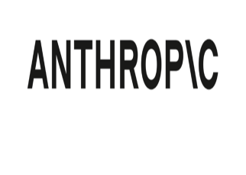
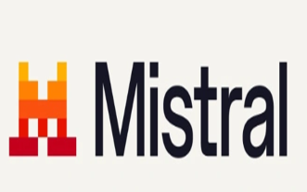
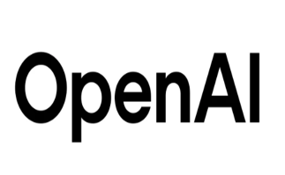
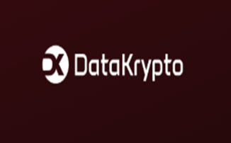

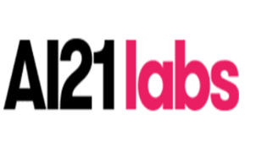
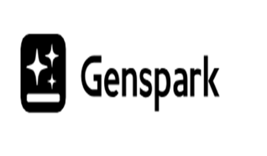
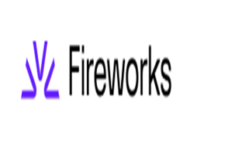


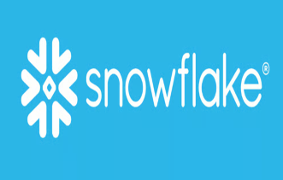
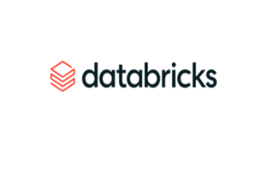
NITYO INFOTECH
Our Key Partnerships
Working alongside the leading names in AI & Data Infrastructure

Slide 12

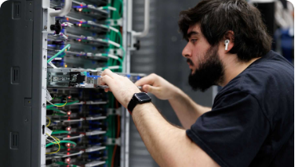









NITYO INFOTECH
AI, Delivered as a Governed Workforce
Nityo brings together global data & AI engineering talent, an agentic workforce built with Wand AI, and enterprise-grade governance — so AI moves from pilot to production without losing control.
Proven at Scale
Human + Agent, Unified
Ready to Engage
1800+ global professionals.
Cross-departmental enterprise workforce model.
Scoped pilots launch weekly.
Let's discuss your AI roadmap — contact your Nityo Infotech engagement lead.

